Slide 1



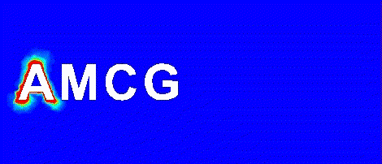
Amin Nadimy
Applied Modelling and Computational Group, Department of Earth Science and Engineering
Supervisors:
Professor C. C. Pain, Dr P. Salinas and Dr A. Nicolle (BP)
ICL-ICAM-BP
30th June 2021

Slide 2


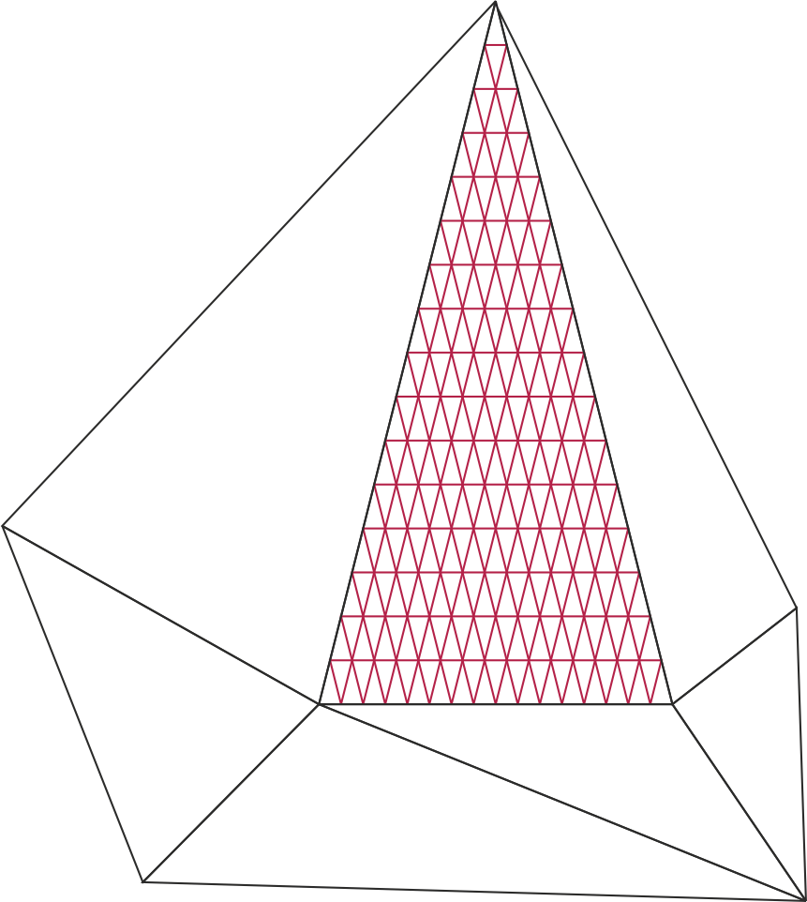
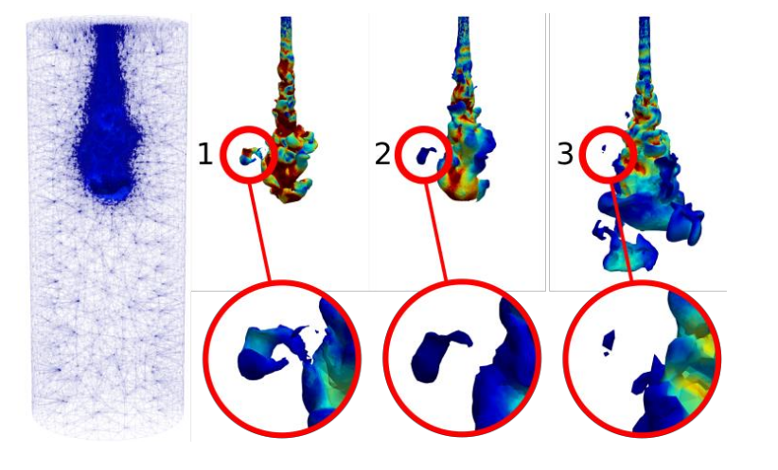
Dynamic semi-structured meshes for fast numerical simulation of Multi-Phase Modelling in the energy industry
Starting date: 01 October 2020
Aim:
This project will develop and implement a semi-structured mesh within the Multi-Fluidity project to significantly improve its speed.
Figure 1. Semi-structured mesh.
Figure 2. Creation and dispersion of a droplet.
ICL-ICAM-BP
30th June 2021

Slide 3
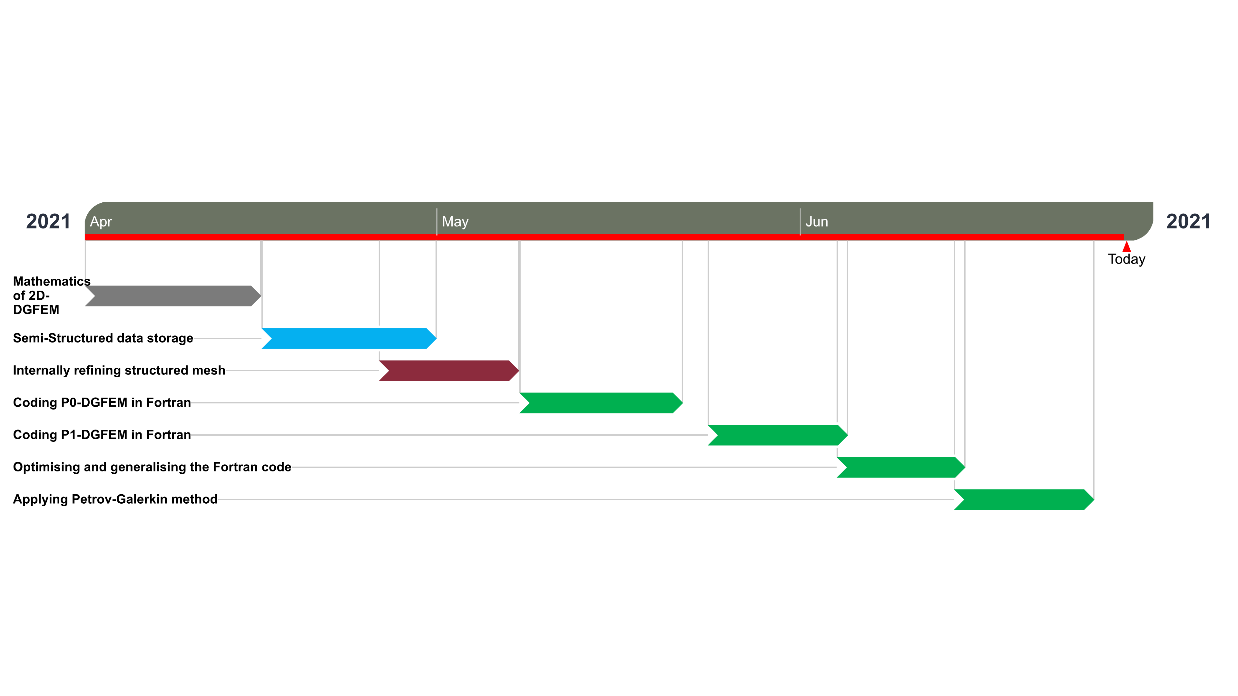
Progress roadmap
Figure 3. Work plan from April to June 2021
ICL-ICAM-BP
30th June 2021

Slide 4
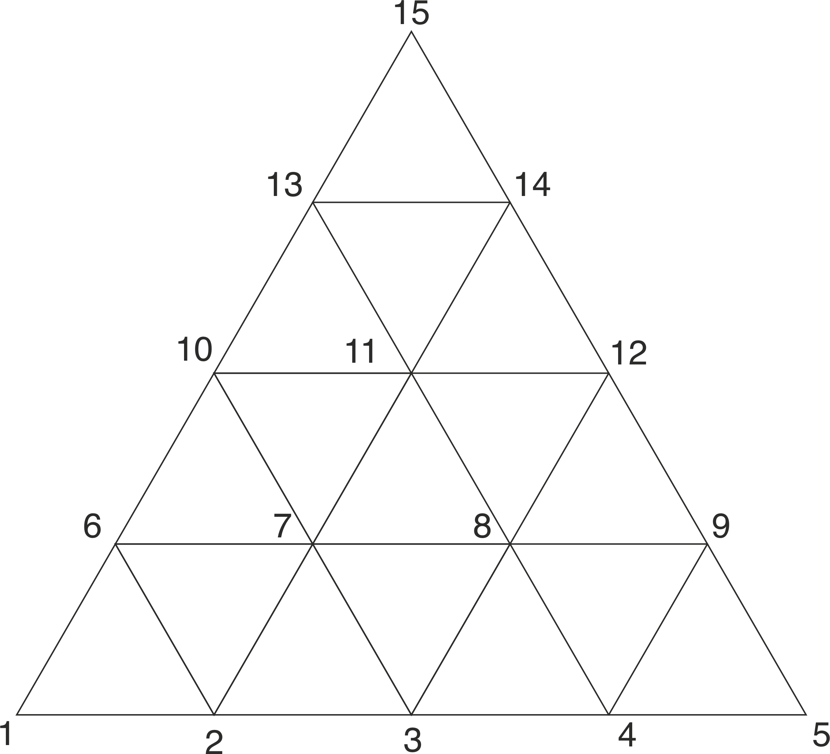
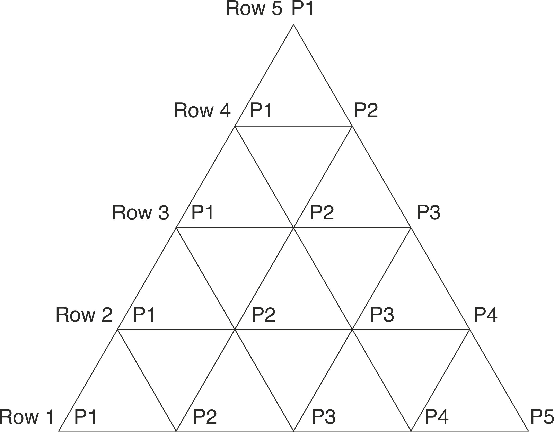
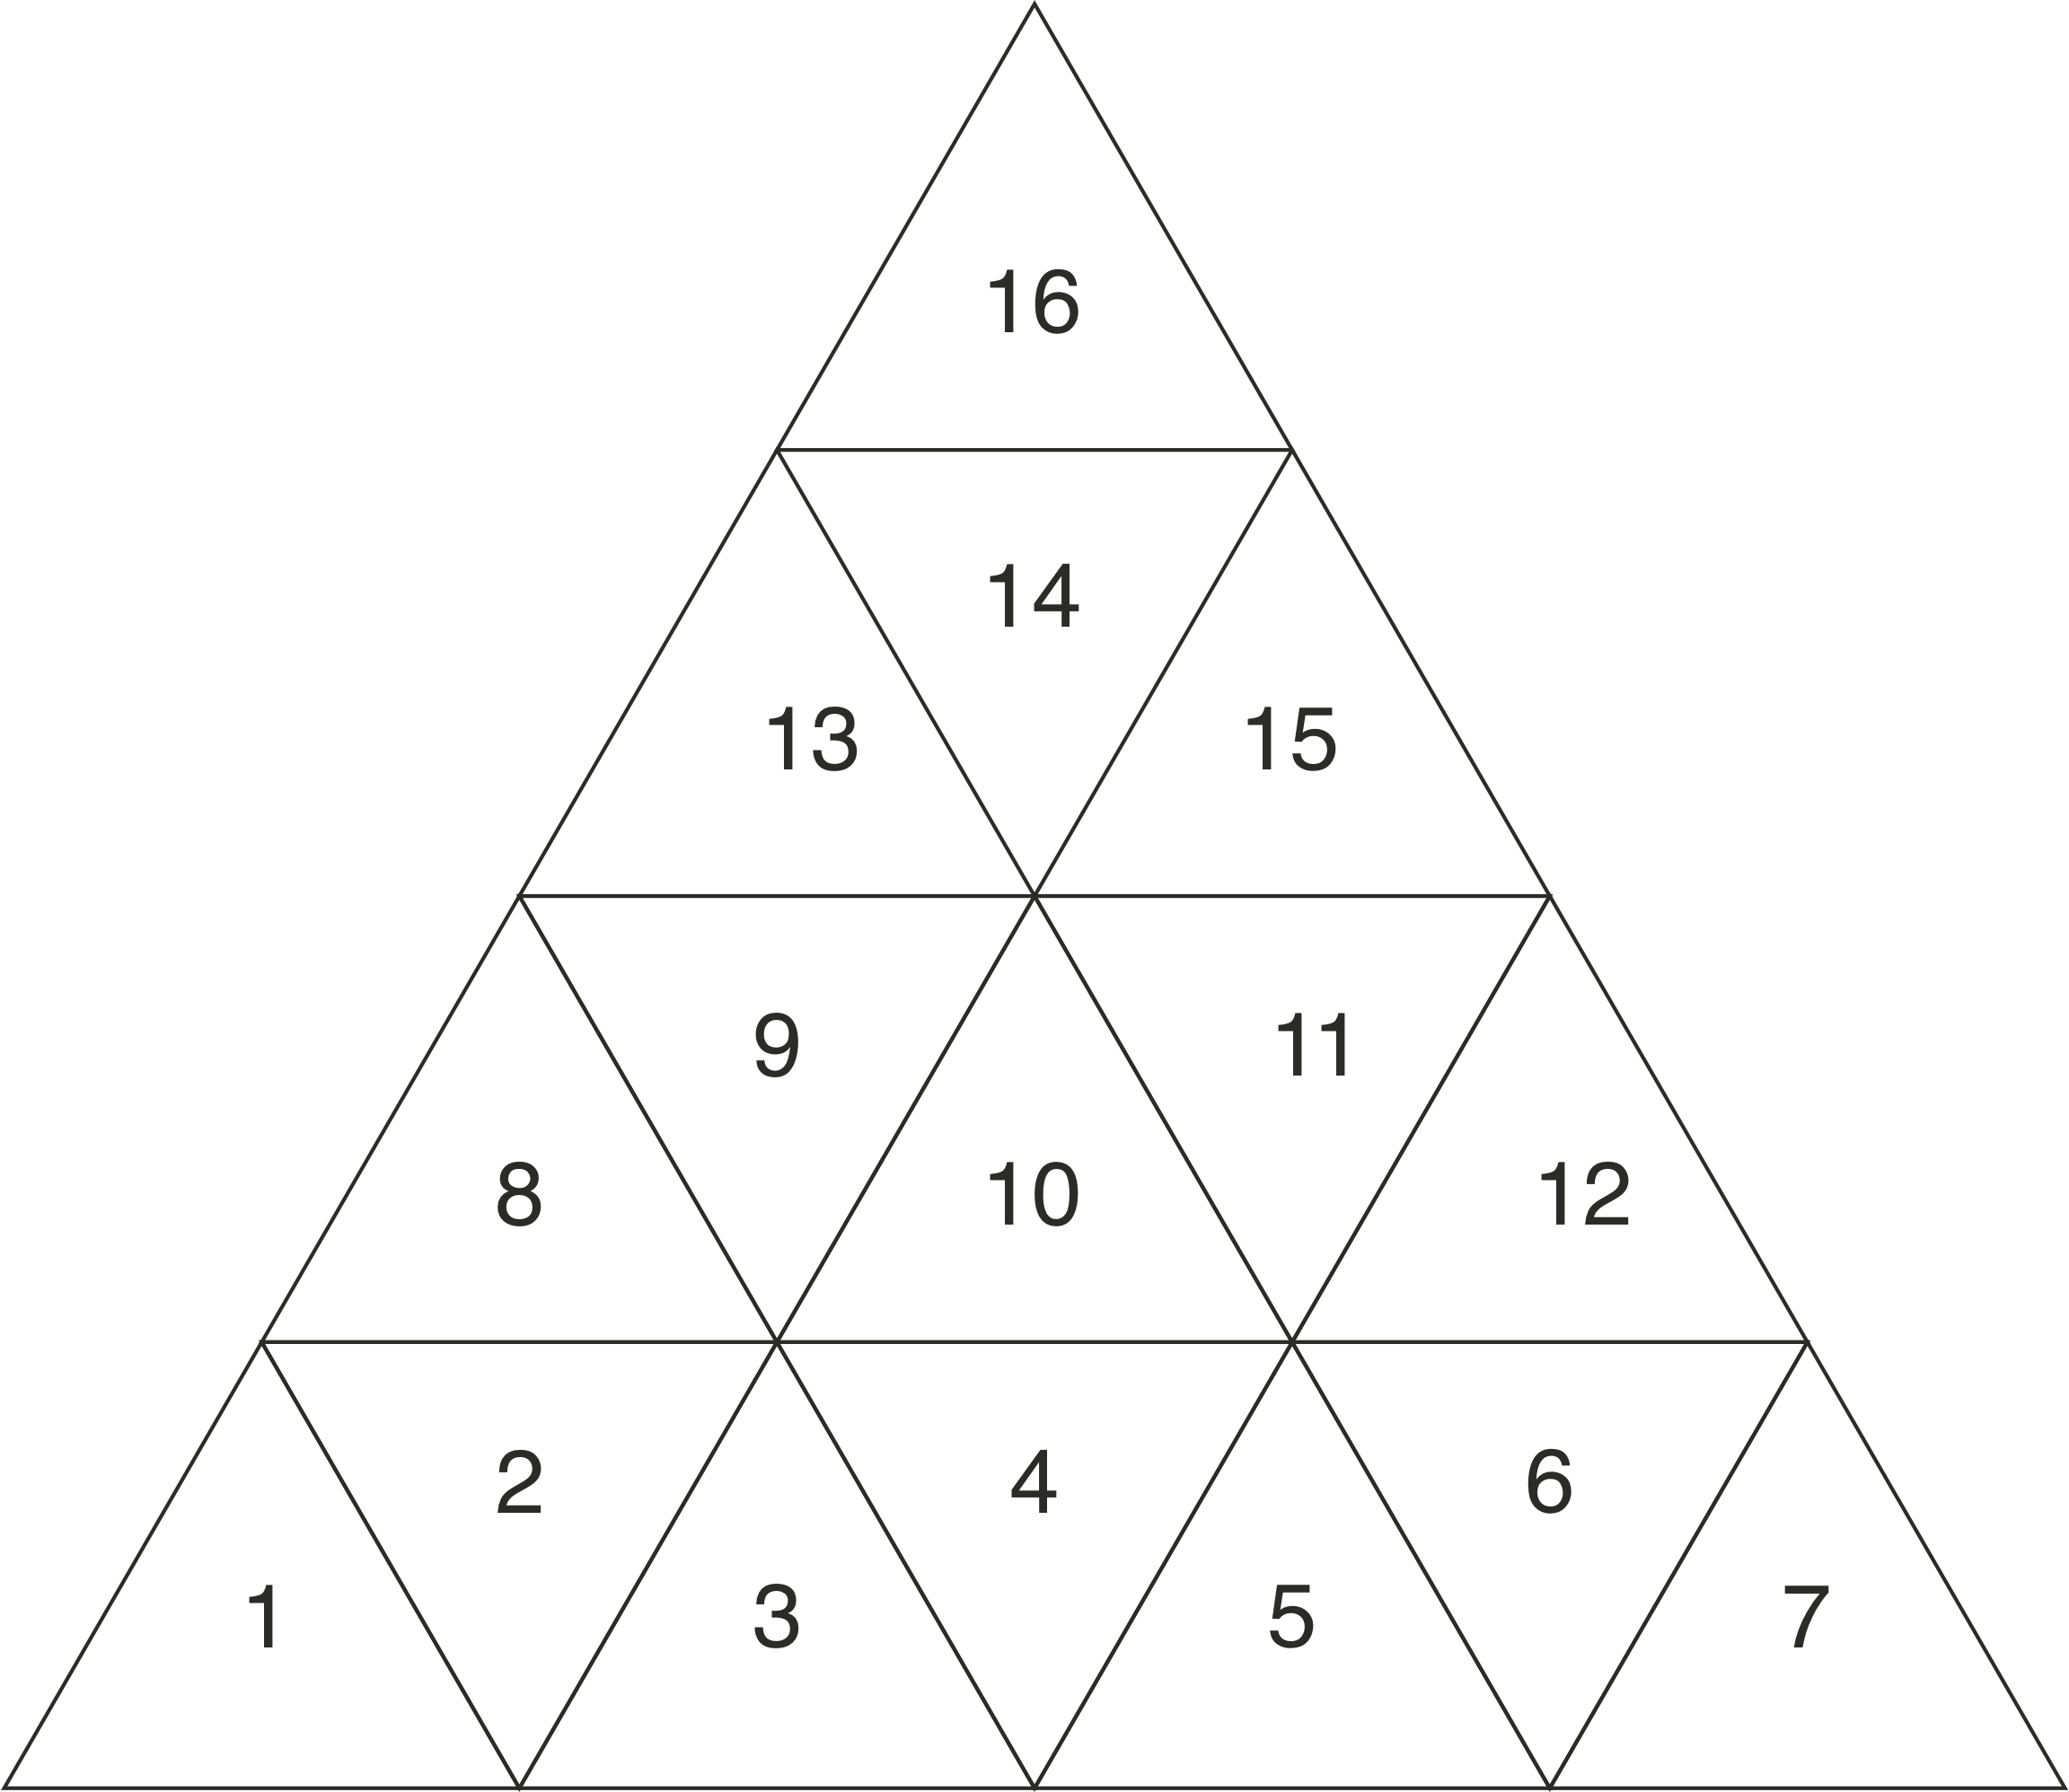
Data Storage
Node and position numbering for P0 and P1
Figure 3.
ICL-ICAM-BP
30th June 2021

Slide 5
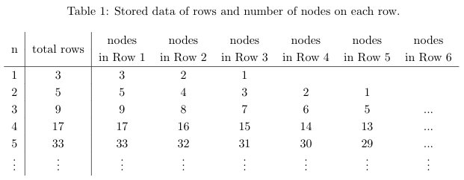
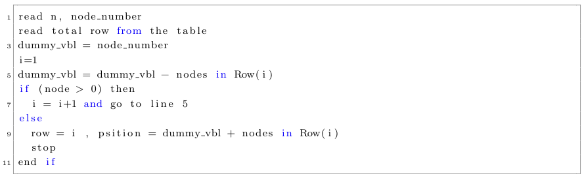
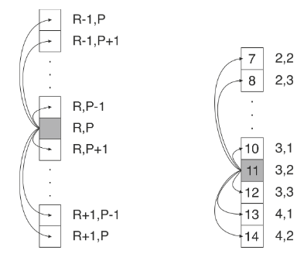
Data Storage for P1
ICL-ICAM-BP
30th June 2021
Figure x.

Slide 6


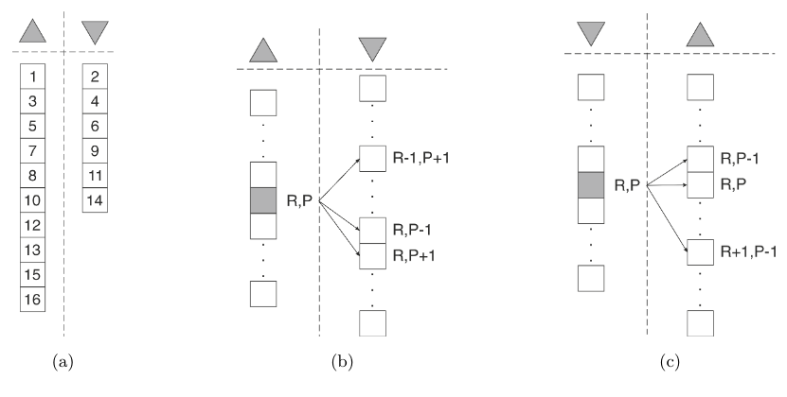
Data Storage for P0
ICL-ICAM-BP
30th June 2021
Figure x.

Slide 7
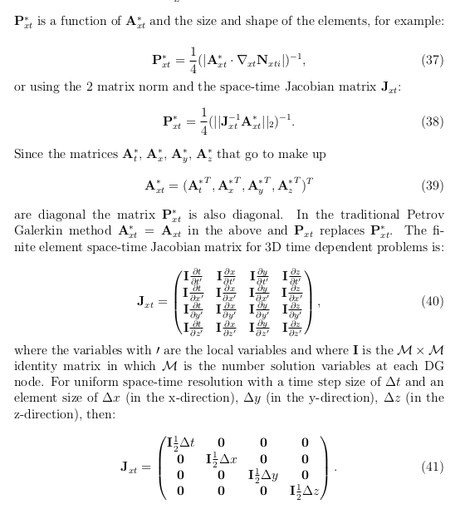
- 2D-DG Petrov-Galerkin FEM: 2 documents
1- Report
1- Theory
ICL-ICAM-BP
30th June 2021

Slide 8
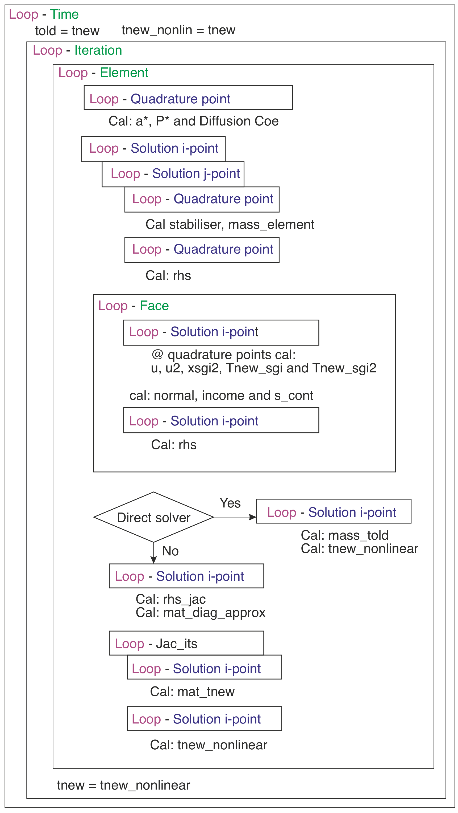
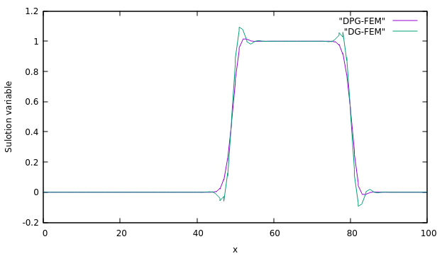
Figure 5. Illustration of the standard 2D-DG against 2D-DPG results for the same number of elements, 100.
Figure 4. Flowchart for the DG Petrov-Galerkin diffusion method.
ICL-ICAM-BP
30th June 2021

Slide 9
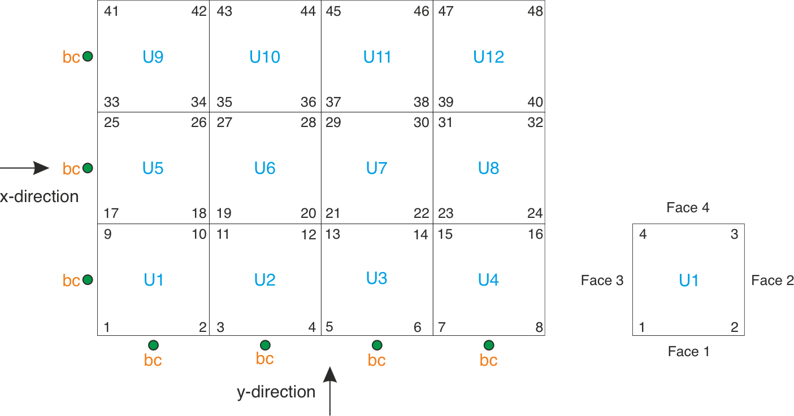
- 2D P0_DG-FEM
- 2D DG-FEM
Figure 6. Travelling a square wave in 2D with 500 elements.
Figure 9. Surface integration using 2-point Gaussian quadrature method.
Figure 8. Volume integration using 3-point Gaussian quadrature method.
Figure 7. P0_2D domain with local & global node numbering.
ICL-ICAM-BP
30th June 2021

Slide 10
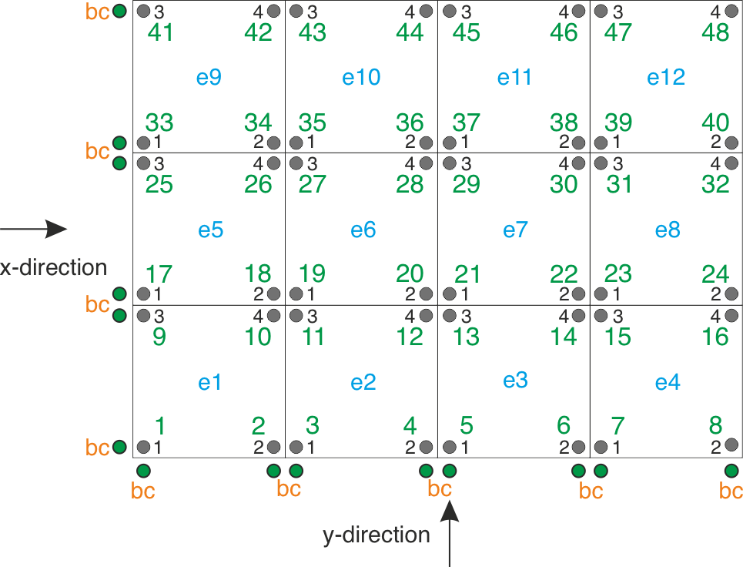
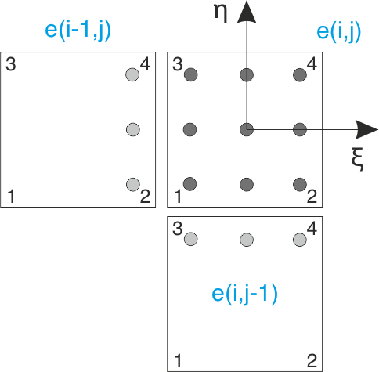
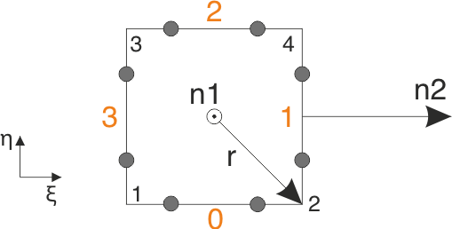
- 2D P0_DG-FEM
- 2D DG-FEM
Figure 6. Travelling a square wave in 2D with 500 elements.
Figure 9. Surface integration using 2-point Gaussian quadrature method.
Figure 8. Volume integration using 3-point Gaussian quadrature method.
Figure 7. 2D domain with local & global node numbering.
ICL-ICAM-BP
30th June 2021

Slide 11
Regular weekly meetings
AMCG catch-up
Porous media/Inertia
BP catch-up
Theory
Delaunay and barycenter triangulation (a few days)
Voronoi diagram
Structured mesh generation
Unstructured mesh generation (~a month)
Semi-structured mesh
Near-future work
Will be working with Dr. Obeysekara on the mixing tank problem (end of March)
2D 1st order square wave DG-FEM (end of March)
semi-structured 2D DG-FEM.
Will be work with Prof. Pain and others on the Fortran code for semi-structured and with space-time within ICFERST/FLUIDITY.
ICL-ICAM-BP
24th March 2021

Slide 12
END
ICL-ICAM-BP
24th March 2021

